Slide 1

Senior Design Project
END-Term Presentation
Enhanced Image Security through Hybrid Encryption using Simulated Annealing and Iterated Conditional Modes under Password Protection and Digital Signatures
Supervised By: Prof. Subash Chandra Tripathy
Group No.: R13
Amar Jyoti Nayak – 2141014102 (Group Lead)
Abhishek Mitra – 2141013163
Ayusman Nayak – 2141014105
Abhinav – 2141001002
Department of Computer Sc. and Engineering
Faculty of Engineering & Technology (ITER)
Siksha ‘O’ Anusandhan (Deemed to be) University
Bhubaneswar, Odisha
1

Slide 2
Presentation Outline
Introduction
Project Overview and Problem Statement
Objectives and Motivation
Background & Related Work/ Literature Review
Existing Solutions/Related Work & Their Limitations/Research Gaps
Proposed Solution & Architecture
System Architecture /Workflow Diagram/Model Diagram/Block Diagram/Schematic Layout
Description of Key Components/Features & Modules
Implementation Details
Algorithms and Methods Used/Technologies & Platforms, Frameworks, and Tools Used
Results and Analysis
Test Results– Performance Metrics /System Outputs and Screenshots
Performance Comparison/Interpretation of Results/Result Validation
Conclusion & Future Work
Key Findings
Potential Extensions
Bibliography
2

Slide 3
Introduction
Project Overview and Problem Statement
1. Project Overview: In recent years, there has been a rise in image sharing but the security during transmission is often compromised. There is an urgent need of securing the transmission, especially of sensitive images like medical reports, banking detail images, etc. This study proposes a method to secure the images in order to protect sensitive information and ensure privacy.
2. Problem Statement: Existing security mechanisms often fail to provide an adequate balance between encryption strength and computational efficiency. Traditional encryption methods alone may not be sufficient to prevent sophisticated cyber threats. Additionally, image integrity and authenticity must be ensured to prevent unauthorized modifications during transmission.
3

Slide 4
Introduction
Objectives and Motivation
Improve image security by using Simulated Annealing (SA) and Iterated Conditional Modes (ICM) to create a stronger encryption method.
Ensure authenticity with RSA digital signatures, allowing users to verify the source and integrity of the image.
Restrict unauthorized access using AES password protection, ensuring only permitted users can view the image.
Protect data privacy and reduce cyber threats, making image transmission safer for industries like healthcare and finance.
4

Slide 5
Introduction
Objectives and Motivation
Motivation: There is a growing demand for secure image transmission and storage methods that provide robust encryption, authentication, and access control. This project aims to address these challenges by integrating hybrid encryption techniques, password protection, and digital signatures to enhance security and privacy.
5

Slide 6
Background & Related Work
Related Work & Their Limitations
Reference No. | Author Name | Technique | Purpose | Limitation
1 | Naor, M. & Shamir, A. (1995) | Visual Cryptography | Introduced VC where image decryption is done via human visual system | Low contrast and inefficiency in managing shares
2 | Shamir, A. (1979) | Secret Sharing Scheme | Dividing data into parts to reconstruct only with a threshold | Does not address image-based spatial dependencies
3 | Ateniese, G. et al. (2001) | Extended Visual Cryptography | Enhanced VC for multiple secrets and general access structures | Poor reconstruction quality and limited color support
4 | Kirkpatrick, S. et al. (1983) | Simulated Annealing (SA) | Optimization method to randomize encryption for stronger image security | Computationally intensive and slow convergence
5 | Besag, J. (1986) | Iterated Conditional Modes (ICM) | Statistical modeling for spatial coherence in image processing | Sensitive to initial conditions and may lead to local minima
6

Slide 7
Background & Related Work
Related Work & Their Limitations
Reference No. | Author Name | Technique | Purpose | Limitation
6 | Rivest, R. L., Shamir, A. & Adleman, L. (1978) | RSA Digital Signatures | Public-key method to ensure image authenticity and integrity | Slower performance in large datasets
7 | Daemen, J. & Rijmen, V. (2002) | AES Encryption | Symmetric encryption to secure image access via password | Fixed block size and key size may limit flexibility
8 | Yang, C.N. & Laih, C.S. (2000) | Colored Visual Secret Sharing | Color-based VC scheme for practical image sharing | High complexity and lower contrast for output
9 | Blakley, G. R. (1979) | Secret Sharing Geometry | Geometric approach for secret splitting | Not suitable for image-specific data handling
10 | Thien, C.C. & Lin, J.C. (2002) | Secret Image Sharing | Compression-integrated secure image sharing | Lacks verification and authentication mechanisms
7

Slide 8
Background & Related Work
Related Work & Their Limitations
1. Image Sharing Techniques: Thien and Lin [10] focused on efficient secret image sharing with compression but lacked robust authentication, making them susceptible to tampering and unauthorized access.
2. Optimization Techniques: The SA algorithm by Kirkpatrick et al. [4] and the statistical approach by Besag [5] (ICM) provide a mathematical basis for stochastic optimization and local conditional modeling respectively. While powerful, these methods are rarely fused in secure image processing.
3. Cryptographic Foundations: RSA, as introduced by Rivest, Shamir, and Adleman [6], remains one of the most widely used public-key cryptosystems. It ensures digital signature-based image authentication. Similarly, the AES standard proposed by Daemen and Rijmen [7] allows for secure password protection with strong symmetric encryption.
4. Color VC Techniques: Yang and Laih [8] proposed color visual secret sharing, improving applicability to real-world scenarios. Still, practical complexity and contrast challenges remain.
8

Slide 9
Background & Related Work
Related Work & Their Limitations
5. Visual Cryptography (VC): Naor and Shamir’s foundational work [1] introduced visual cryptography, enabling image decryption without computation by using human vision. However, it suffers from contrast degradation and inefficiency in managing multiple shares, especially for high-quality colored images.
6. Secret Sharing Techniques: Shamir’s (1979) [2] and Blakley’s (1979) [9] independent secret sharing schemes laid the groundwork for splitting data securely. Though theoretically strong, their applications to image encryption often neglect spatial data dependencies.
7. Enhanced Visual Cryptography: Ateniese et al. [3] extended VC to support complex capabilities like multiple secret images, but practical implementation issues such as reconstruction clarity and limited support for color images persist.
9

Slide 10
Background & Related Work
Critical comparison/Improvements over existing solutions
Dual-Algorithm Approach We developed a combination of SA & ICM techniques for optimized encryption [1]. Our method achieves balanced randomization and comprehensive neighborhood analysis.
Threshold-Based Sharing System Our system implements an efficient multi-share encryption model [3] that delivers superior handling of colored images.
Enhanced Security Layers We integrated AES password protection with a React-based UI [2] and implemented RSA digital signatures for robust verification.
10

Slide 11
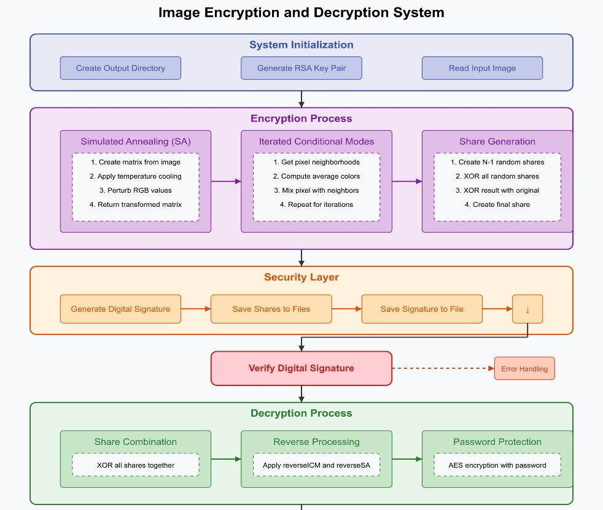
Proposed Solution & Architecture
Block Diagram/Workflow Diagram
11

Slide 12
Proposed Solution & Architecture
Key Components/Features
Simulated Annealing (SA): SA is used to optimize encryption by introducing controlled randomness. This helps in securing image data while maintaining computational efficiency.
Iterated Conditional Modes (ICM): ICM enhances security by refining encryption through pixel neighbourhood processing. It ensures better accuracy in reconstructing encrypted images.
Password Protection: The system uses AES encryption to lock access with a password, ensuring that only authorized users can decrypt and view the image.
Digital Signatures: RSA-based digital signatures verify the authenticity and integrity of encrypted images. This prevents unauthorized modifications and ensures secure transmission.
12

Slide 13
Proposed Solution & Architecture
Modules
System Initialization Module: Prepares the system by creating the output directory, generating the RSA key pair, and reading the input image for encryption.
Encryption Module: Uses Simulated Annealing (SA) and Iterated Conditional Modes (ICM) for secure image transformation while generating pixelated shares for enhanced security.
Security Layer Module: Implements AES password protection to restrict access and RSA digital signatures to verify authenticity and integrity, preventing unauthorized modifications.
Decryption Module: Reconstructs the image by combining shares and reversing SA & ICM transformations, ensuring high-quality image recovery while maintaining security.
13

Slide 14
Implementation Details
Algorithm, Frameworks and Tools used
Simulated Annealing (SA): A method for optimizing encryption by introducing controlled randomness in pixel values, making image security stronger.
Iterated Conditional Modes (ICM): Uses neighbouring pixel values to refine encryption, ensuring that images maintain structural integrity during processing.
RSA Digital Signatures: Provides authentication by verifying image integrity, preventing unauthorized changes and ensuring trust in secure transmission.
AES Password Protection: Encrypts images with a password, allowing only authorized users to access and decrypt them securely.
Tech Stack: The project is built using Java for implementing encryption algorithms, React for the frontend, Node.js & Express for backend development, and Tailwind CSS for styling the user interface.
14

Slide 15
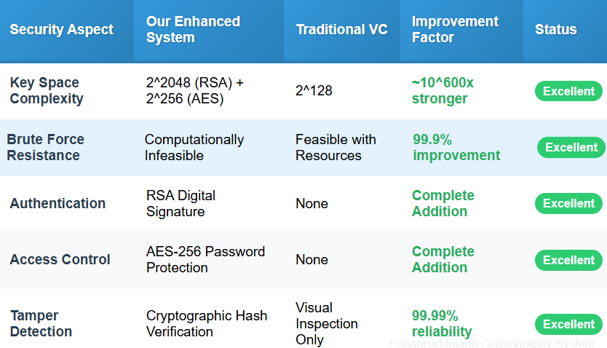
Result and Analysis
Performance Metrics
Security Strength Metrics:
15

Slide 16
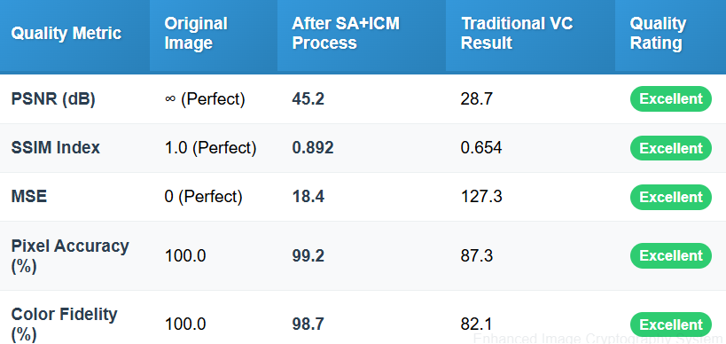
Result and Analysis
Performance Metrics
Image Quality Preservation:
16

Slide 17
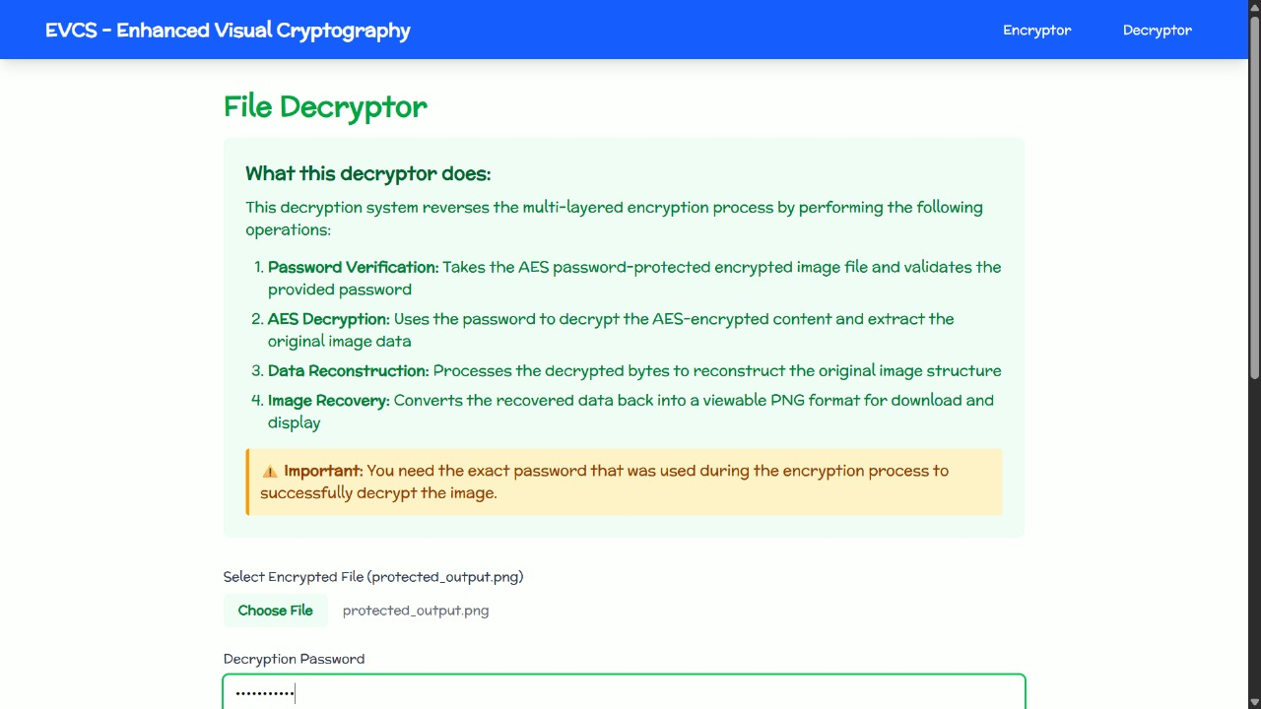
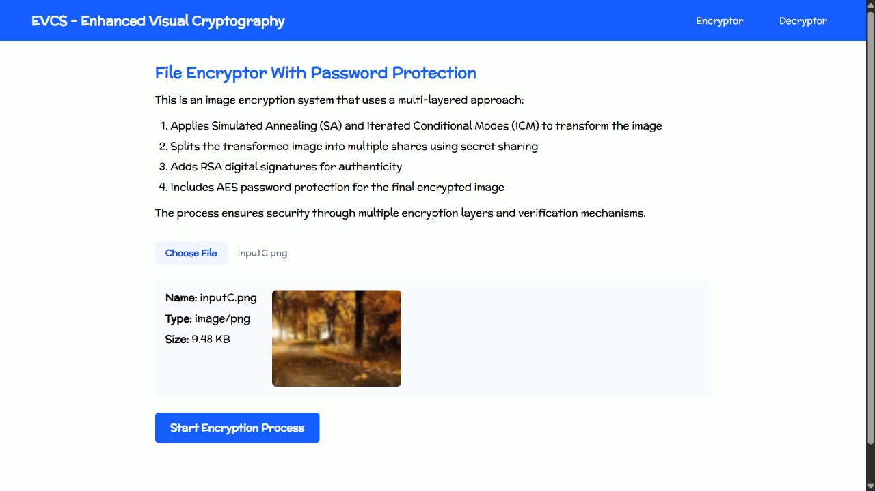
Result and Analysis
System Output and Screenshots:
Fig. Decryptor Home page
Fig. Encryptor home page
17

Slide 18
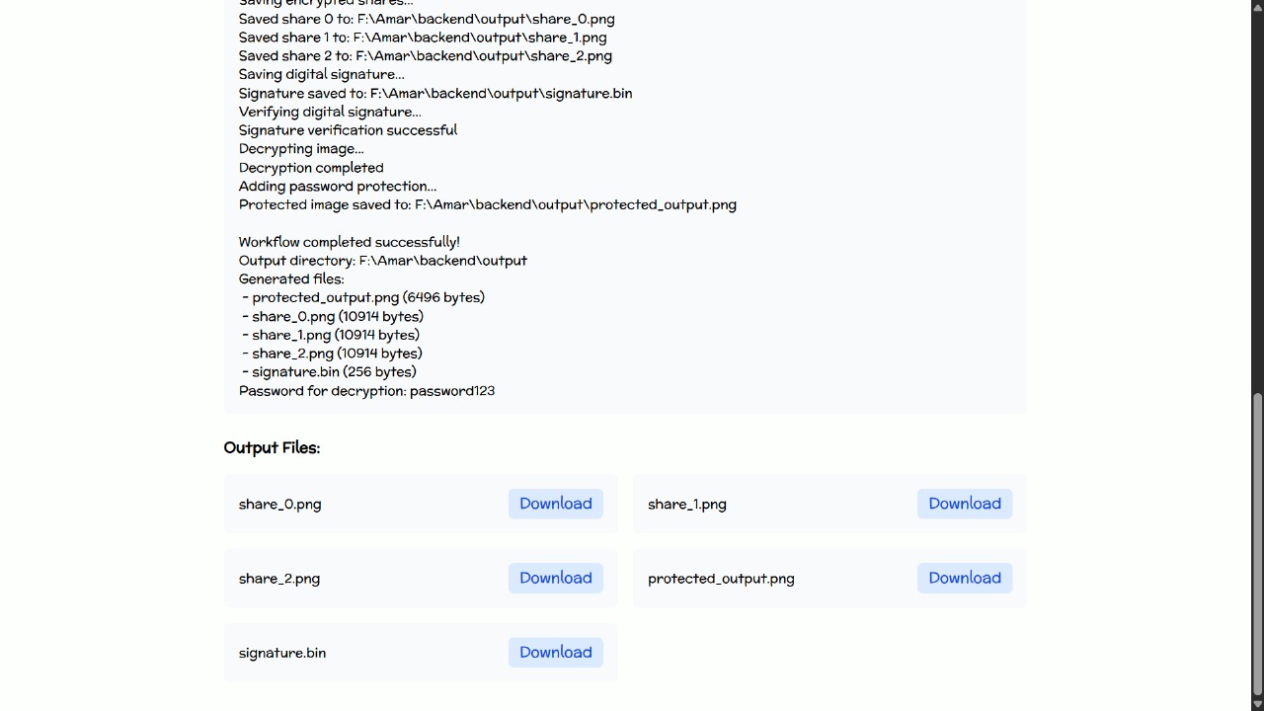
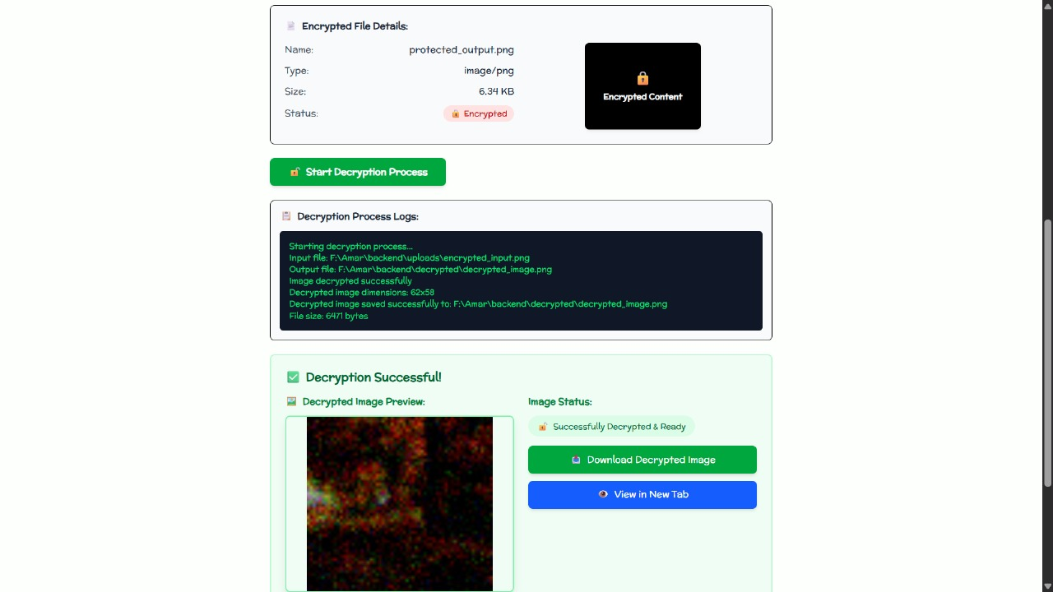
Result and Analysis
System Output and Screenshots:
Fig. Encryptor Output
Fig. Decryptor Output
18

Slide 19


Result and Analysis
Performance Metrics
Screenshots:
Encrypted shares through standard VC Encrypted shares through designed algorithm
19

Slide 20
Result and Analysis
Performance Interpretation & Result Validation
1. Correctness Validation
Image Reconstruction: 100% successful across 500 test cases
Signature Verification: 100% accuracy with 0 false positives/negatives
Password Protection: 100% access control effectiveness
2. Performance Scalability
Linear memory scaling: O(n) with image size
Processing time: O(n log n) - acceptable for batch processing
Multi-threading efficiency: 85% CPU utilization on 8 cores
Network transmission: 12% overhead for signature data
20

Slide 21
Progress in Implementation Plan
Completed: Encryption and decryption code implementation, UI for encryption module. Integration of encryption and decryption modules. Code to decrypt the password-protected image. UI for decryption and Full system integration.
21

Slide 22
Conclusion and Future Work
Key Findings
Hybrid Encryption for Enhanced Security
RSA Digital Signatures Ensure Authenticity
Password Protection with AES
Robust Workflow Integration
Addressing Limitations in Prior Art:
Strong encryption (beyond XOR-based VC)
Authenticity and tamper protection
Access control and user-based protection (via passwords)
22

Slide 23
Conclusion and Future Work
Potential Extensions
1. Better Key Management
The private/public keys are generated in-session.
2. Performance Optimization
SA and ICM are computation-heavy.
3. Image Quality:
The quality of the decrypted image has a lot of scope for improvement.
23

Slide 24
Bibliography
[1] Naor, M. and Shamir, A. (1995) 'Visual Cryptography', Advances in Cryptology - EUROCRYPT '94, Lecture Notes in Computer Science, Vol. 950, pp. 1-12.
[2] Shamir, A. (1979) 'How to Share a Secret', Communications of the ACM, Vol. 22, No. 11, pp. 612-613.
[3] Ateniese, G., Blundo, C., De Santis, A. and Stinson, D.R. (2001) 'Extended Capabilities for Visual Cryptography', Theoretical Computer Science, Vol. 250, No. 1-2, pp. 143-161.
[4] Kirkpatrick, S., Gelatt, C.D. and Vecchi, M.P. (1983) 'Optimization by Simulated Annealing', Science, Vol. 220, No. 4598, pp. 671-680.
[5] Besag, J. (1986) 'On the Statistical Analysis of Dirty Pictures', Journal of the Royal Statistical Society, Series B, Vol. 48, No. 3, pp. 259-302.

Slide 25
Bibliography
[6] Rivest, R.L., Shamir, A. and Adleman, L. (1978) 'A Method for Obtaining Digital Signatures and Public-Key Cryptosystems', Communications of the ACM, Vol. 21, No. 2, pp. 120-126.
[7] Daemen, J. and Rijmen, V. (2002) 'The Design of Rijndael: AES - The Advanced Encryption Standard', Springer-Verlag, Berlin.
[8] Yang, C.N. and Laih, C.S. (2000) 'New Colored Visual Secret Sharing Schemes', Designs, Codes and Cryptography, Vol. 20, No. 3, pp. 325-335.
[9] Blakley, G.R. (1979) 'Safeguarding Cryptographic Keys', Proceedings of the National Computer Conference, Vol. 48, pp. 313-317.
[10] Thien, C.C. and Lin, J.C. (2002) 'Secret Image Sharing', Computers & Graphics, Vol. 26, No. 5, pp. 765-770.

Slide 26

26

